Slide 1
AI-Powered Threat Detection for Cloud Networks
ICT Capstone Project Presentation
Group: 1 Unit: COIT20265
Project Mentor: Dr. Fariza Sabrina Term: 2024 Term 3
Students: Jay Dilipbhai Yadav (BNE)
Sonam Pelden (BNE)
Harshkumar Dharmendrabhai Patel (BNE)
Akshitha Ishan Ranasinghe Walgama
Ranasinghe Arachchilage (BNE)

Slide 2
Content
Introduction
Background Study
Aim and Objective
Literature Review
Methodology
Dataset Description
Threat Detection Using AI
Methodology
Handling missing values
Pre-processed data
Exploratory Data Analysis
Model Evaluation
Model Comparison
Web application Functionalities
References

Slide 3
Introduction
AI-Powered Threat Detection
An advanced system leveraging machine learning models to identify, classify, and mitigate cyber threats in real time.
Detects vulnerabilities using natural language processing and network analysis, offering actionable insights for enhanced security.
Combines AI models with a user-friendly web application for seamless threat detection and response.

Slide 4
Background Study
Cloud as a Business Backbone: The cloud has transitioned from an emerging technology to an essential infrastructure for modern businesses, offering flexibility, scalability, and cost savings(Unlu, 2025).
Inherent Security Risks: Cloud environments are not inherently secure, with 45% of breaches being cloud-based, highlighting the vulnerabilities within multi-cloud setups(Unlu, 2025).
Shared Responsibility Model: Cloud security is a shared responsibility between the customer and the cloud provider, emphasizing the importance of robust security strategies(Unlu, 2025).

Slide 5
Background Study
Industry Challenges:
69% of organizations have reported data breaches or exposures caused by multi-cloud security misconfigurations(Unlu, 2025).
96% of organizations face challenges in implementing effective cloud strategies.
Cloud Security Incidents:
80% of companies reported experiencing cloud security incidents in 2023, with 27% of public cloud incidents, marking a significant rise from 10% the previous year.

Slide 6
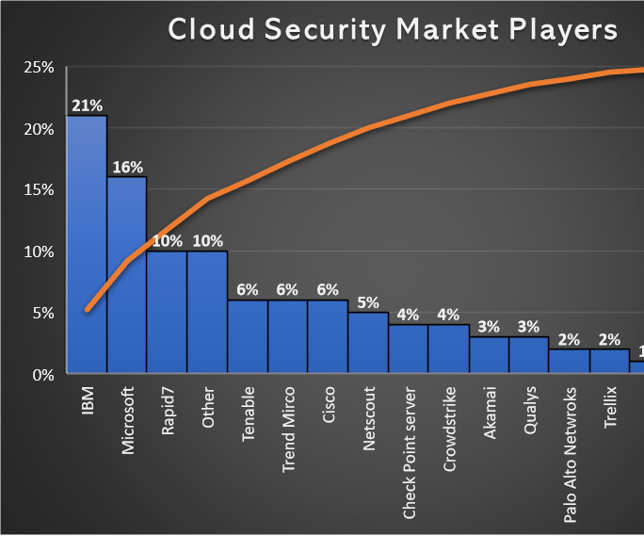
Background study
Cloud Adoption Trends:
76% of enterprises are adopting multi-cloud strategies(Unlu, 2025).
35% of industries host over 50% of their workloads in the cloud, with 29% planning further migration.
Market Statistics:
The cloud security market was valued at $20.54 billion in 2022, indicating its growing significance for businesses globally.
IBM dominates the market with a 21% share, reflecting its leadership in the cloud security industry.
Data Breaches: In the fourth quarter of 2023, more than 8 million records were exposed due to data breaches, underscoring the pressing need for robust cloud security measures.

Slide 7
Aim and Objectives
The main aim of this project is to develop a real-time threat detection system for a company forum, ensuring secure communication by identifying and mitigating risks effectively.
Detect threats in real-time from employee posts on the company forum.
Notify the admin when a potential threat is identified.
Enable admin review and block users involved in malicious activities.
Permanently block users upon confirmed violations to ensure long-term security.
Maintain a safe and secure environment for employee communication.

Slide 8
Literature Review
Authors | Year | Methodology | Findings | Limitations
Mallikarjunaradhya, V., Pothukuchi, A.S., and Kota, L.V. | 2023 | Market dynamics and strategic analysis of AI's role in cloud security(Mallikarjunaradhya, Pothukuchi and Kota, 2023) | AI improves adaptive, predictive, and automated cloud security; highlights challenges for product managers | Lacks specific implementation examples; theoretical analysis
Wang, B.-X., Chen, J.-L., and Yu, C.-L. | 2022 | Development of AI@NTDS system using feature evaluation and ML algorithms (LightGBM, Random Forest, K-NN) (Wang, Chen and Yu, 2022) | Achieved 99.20% accuracy with AI@NTDS for network threat detection | Limited dataset scope (SSH and Telnet only); potential generalization issues
Bibi, I., Akhunzada, A., and Kumar, N. | 2022 | Proposed ConvLSTM2D for IIoT threat detection with self-optimizing capabilities(Bibi, Akhunzada and Kumar, 2022) | Achieved superior detection accuracy in IIoT threats using ConvLSTM2D; highly scalable approach | Tradeoff in speed efficiency; lack of standard architectures for IIoT systems
Bhardwaj, A.K., Dutta, P.K., and Chintale, P. | 2024 | AI anomaly detection framework for Kubernetes security using real-time telemetry analysis(Bhardwaj, Dutta and Chintale, 2024) | 92% accuracy in identifying Kubernetes threats; reduced response time by 67% with automated protocols | Challenges with false positives and resource management; dependency on data quality
Nacheva, R., and Azeroual, O. | 2024 | Proposed multivector threat detection for IIoT with Convolutional LSTM2D(Nacheva and Azeroual, 2024) | Significant improvements in IIoT threat mitigation with ConvLSTM2D; effective multivector defense | Trivial tradeoff in speed efficiency; limited evaluation on diverse IIoT systems

Slide 9
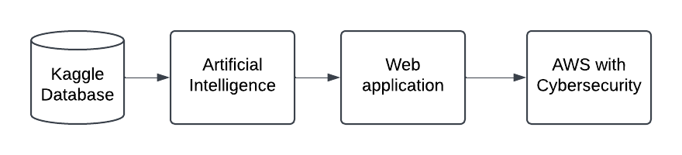
Methodology
Kaggle Database: The initial stage involves accessing data from a Kaggle dataset, which serves as the foundation for training and testing the AI models.
Artificial Intelligence: Advanced AI algorithms process the dataset to detect and predict potential threats, creating an intelligent layer for decision-making.
Web Application & AWS with Cybersecurity: The processed data is integrated into a secure web application hosted on AWS, leveraging robust cybersecurity protocols to manage threats effectively.

Slide 10
Dataset Description
Dataset Link: https://www.kaggle.com/datasets/ramoliyafenil/text-based-cyber-threat-detection/data
Includes network traffic, textual messages, and entity relationships for threat detection.
Supports threat detection, incident response, and advanced ML/DL applications.
Contains IDs, text, labels, diagnoses, and solutions for threats.
Ready-to-use refined datasets optimized for analysis and training.

Slide 11
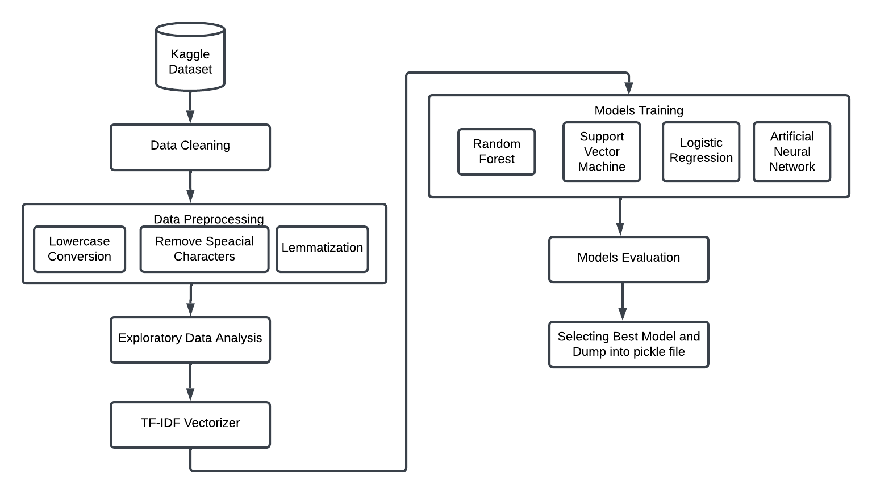
Threat Detection Using AI

Slide 12
Methodology
Kaggle Dataset: The process begins with acquiring a dataset from Kaggle, containing cyber threat-related data for analysis and model training.
Data Cleaning: Removes inconsistencies, duplicates, or irrelevant data to ensure the dataset is ready for preprocessing.
Data Preprocessing:
Lowercase Conversion: Converts text to lowercase for uniformity.
Remove Special Characters: Eliminates unwanted symbols or characters to simplify text.
Lemmatization: Reduces words to their base or root form for better analysis.
Exploratory Data Analysis (EDA): Analyzes the cleaned dataset to uncover patterns, trends, and potential insights for better understanding.
TF-IDF Vectorizer: Converts textual data into numerical form by assigning weights based on term frequency and document frequency for use in machine learning models.

Slide 13
Methodology
Model Training: Trains four machine learning models (Random Forest, Support Vector Machine, Logistic Regression, and Artificial Neural Network) using the vectorized data.
Model Evaluation: Evaluates the performance of all trained models using metrics such as accuracy, precision, recall, and F1-score.
Selecting the Best Model: Compares the evaluation results to identify the best-performing model.
Dumping the Model: Saves the best model into a pickle file for future use or deployment.
Outcome: The process results in a robust machine learning model ready for deployment in detecting cyber threats effectively.

Slide 14
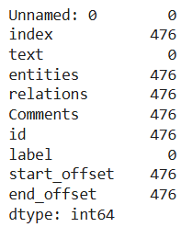
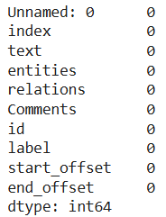
Handling missing values
The below figures shows, number of missing values in each column and cleaned data

Slide 15
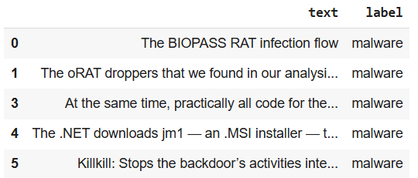
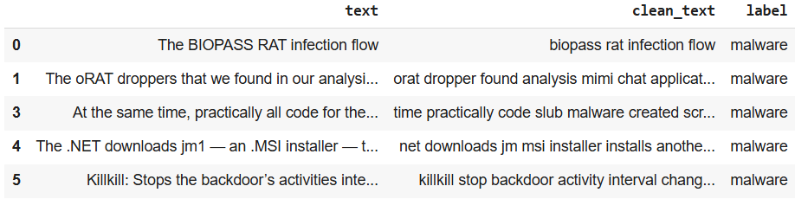
Pre-processed Data
Below figures show that sample original data and pre-processed data.

Slide 16
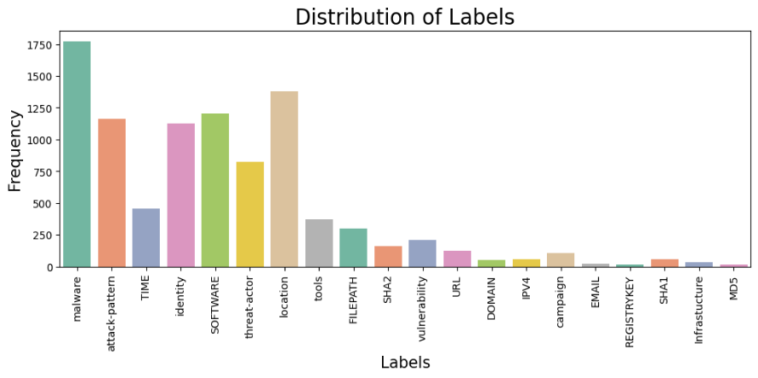
Exploratory Data Analysis
The frequency of dataset labels or categories is shown in a bar chart. Malware appears to be the most common attack label.
Lower frequencies are linked to labels like "threat-actor," "location," and "tools.“
This visualisation provides insights on the distribution of categories within the data set, which can be useful for understanding the model of the data and making decisions in later analysis or modelling phases.

Slide 17
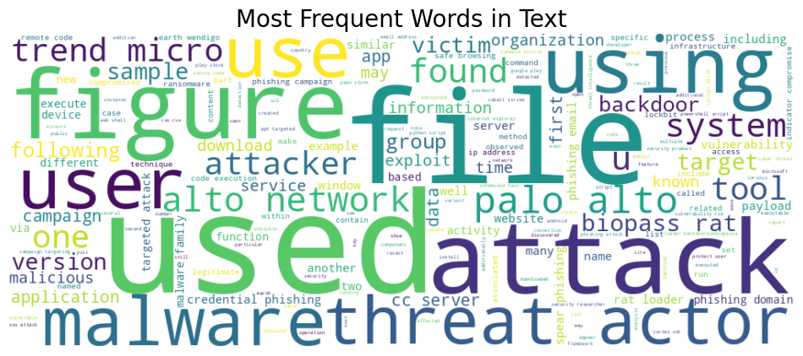
Exploratory Data Analysis
In the text data, the word cloud presents the most common words. Words like "attack," "malware," "threat," "user," and "phishing" imply a focus on cyber security threats.
This is supported by the words "ransomware," "exploit," and "victim." Attack plan analysis is suggested by words like "tool," "technique," and "campaign“.
The word cloud displays text data's primary cyber security themes and vocabulary.

Slide 18
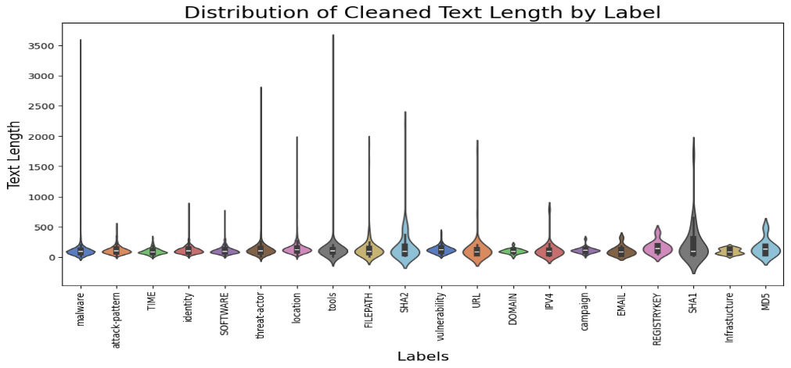
Exploratory Data Analysis
For dataset categories or labels, violin charts show text length distributions. The violin shapes' widths show data point density at different text lengths.
Some labels, like "tools" and "FILEPATH," have larger text descriptions than others, like "attack-pattern" and "SHA2."
This information can aid in understanding the characteristics of various categories and inform feature engineering or model selection

Slide 19
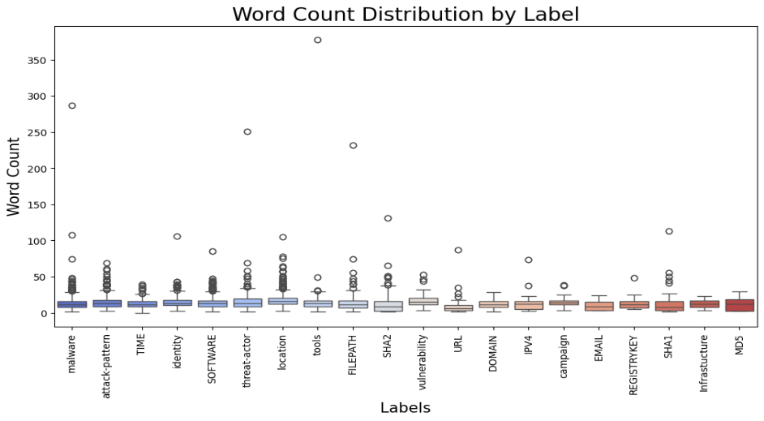
Exploratory Data Analysis
The box plot displays the data set's word count distribution by label. Boxes show the interquartile range (IQR) with a median line.
Outliers are points that stretch 1.5 times the IQR. The plot demonstrates that labels like "tools" and "FILEPATH" tend to have longer word counts than labels like "malware" and "attack-pattern," suggesting that descriptions of these labels tend to be longer and more detailed.
This information is valuable for understanding the characteristics of separate categories and influencing feature engineering or model selection.

Slide 20
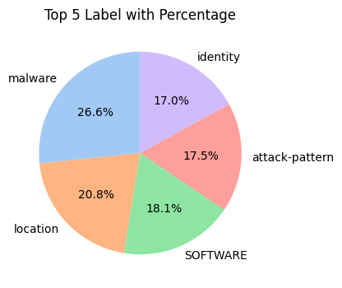
Exploratory Data Analysis
The data set's pie graphic presents the top five labels' distribution. Most data is marked "malware" (26.6%), followed by "location" (20.8%), "SOFTWARE" (18.1%), "attack-pattern" (17.5%), and "identity" (17.0% This visualisation illustrates the top categories within the data set, which is valuable for understanding the data's composition and making decisions in later analysis or modelling phases.

Slide 21
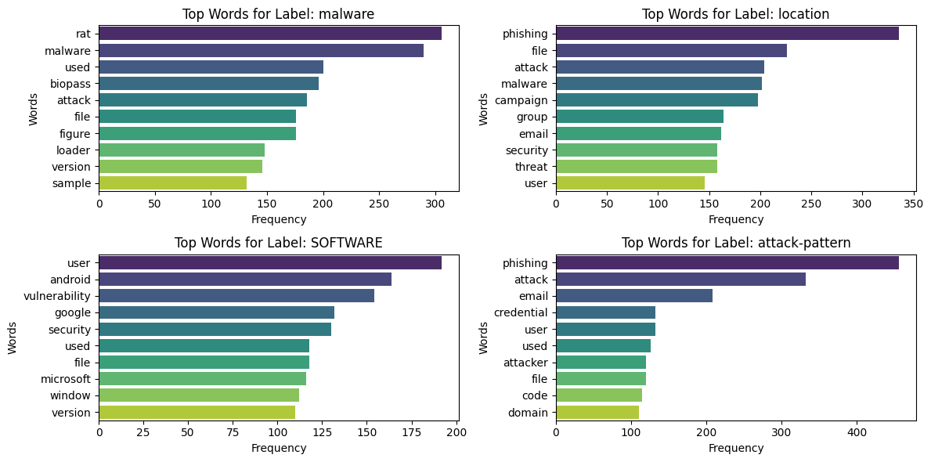
Exploratory Data Analysis
The bar charts illustrate the top four dataset labels' most common words: "malware," "location," "SOFTWARE," and "attack-pattern."
Insights into the nature and data of each label are provided by this analysis, which can be used to comprehend the data's themes and perhaps guide the construction of a new label or model.

Slide 22
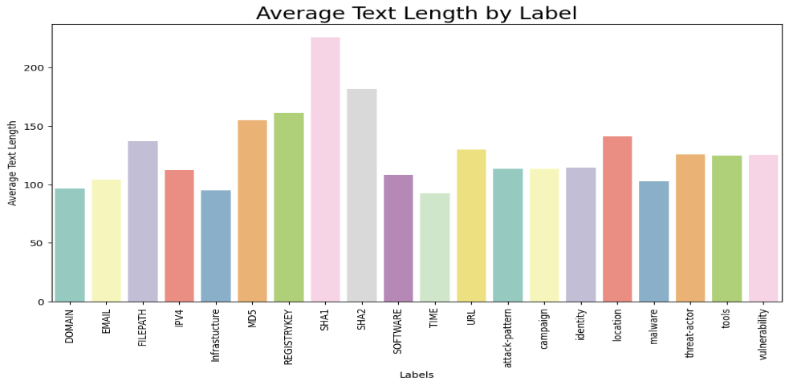
Exploratory Data Analysis
A bar chart shows typical label text descriptions (length). Labels like "SHA1", "SHA2", and "SOFTWARE" tend to have longer text, suggesting more detailed descriptions.
The average text length of labels like "EMAIL", "IPV4", and "DOMAIN" is shorter, indicating more concise descriptions.
This information can aid in understanding the characteristics of various categories and inform feature engineering or model selection.

Slide 23
Model Evaluation - ANN
The table presents the evaluation metrics (Precision, Recall, F1-score, and Support) for an Artificial Neural Network (ANN) model across various class labels in a cybersecurity context.
It highlights the model's performance, with overall accuracy of 0.88, macro average F1-score of 0.84, and weighted average F1-score of 0.88 across 1893 instances.
Class Name | Precision | Recall | F1-score | Support
DOMAIN | 1 | 0.75 | 0.86 | 12
EMAIL | 0.8 | 1 | 0.89 | 4
FILEPATH | 0.77 | 0.88 | 0.82 | 66
IPV4 | 0.85 | 1 | 0.92 | 11
Infrastucture | 1 | 1 | 1 | 8
MD5 | 0 | 0 | 0 | 4
REGISTRYKEY | 1 | 1 | 1 | 4
SHA1 | 1 | 0.69 | 0.82 | 13
SHA2 | 0.9 | 0.71 | 0.79 | 38
SOFTWARE | 0.92 | 0.88 | 0.9 | 239
TIME | 0.78 | 0.82 | 0.8 | 97
URL | 1 | 0.95 | 0.97 | 20
attack-pattern | 0.86 | 0.9 | 0.88 | 221
campaign | 0.73 | 0.83 | 0.78 | 23
identity | 0.88 | 0.89 | 0.88 | 238
location | 0.85 | 0.85 | 0.85 | 242
malware | 0.94 | 0.9 | 0.92 | 364
threat-actor | 0.86 | 0.93 | 0.89 | 179
tools | 1 | 0.91 | 0.95 | 77
vulnerability | 0.83 | 0.88 | 0.85 | 33
accuracy | 0.88 |  |  | 1893
macro avg | 0.85 | 0.84 | 0.84 | 1893
weighted avg | 0.88 | 0.88 | 0.88 | 1893

Slide 24
Model Evaluation – Random Forest
Class Name | Precision | Recall | F1-score | Support
DOMAIN | 1 | 0.75 | 0.86 | 12
EMAIL | 1 | 1 | 1 | 4
FILEPATH | 1 | 0.8 | 0.89 | 66
IPV4 | 1 | 1 | 1 | 11
Infrastucture | 1 | 0.75 | 0.86 | 8
MD5 | 1 | 0.5 | 0.67 | 4
REGISTRYKEY | 1 | 1 | 1 | 4
SHA1 | 0.69 | 0.69 | 0.69 | 13
SHA2 | 0.64 | 0.79 | 0.71 | 38
SOFTWARE | 0.9 | 0.9 | 0.9 | 239
TIME | 0.98 | 0.84 | 0.9 | 97
URL | 1 | 0.95 | 0.97 | 20
attack-pattern | 0.89 | 0.88 | 0.89 | 221
campaign | 0.71 | 0.87 | 0.78 | 23
identity | 0.91 | 0.89 | 0.9 | 238
location | 0.89 | 0.87 | 0.88 | 242
malware | 0.9 | 0.94 | 0.92 | 364
threat-actor | 0.87 | 0.96 | 0.91 | 179
tools | 0.97 | 0.96 | 0.97 | 77
vulnerability | 0.81 | 0.91 | 0.86 | 33
accuracy | 0.9 |  |  | 1893
macro avg | 0.91 | 0.86 | 0.88 | 1893
weighted avg | 0.9 | 0.9 | 0.9 | 1893
The table displays the evaluation metrics (Precision, Recall, F1-score, and Support) for a Random Forest model applied to a multi-class classification problem.
The model achieves an overall accuracy of 0.90, with macro-average F1-score of 0.88 and weighted-average F1-score of 0.90, indicating strong performance across most classes.

Slide 25
Model Evaluation – SVM
The table evaluates the SVM model's performance across multiple classes, showing an overall accuracy of 0.77 with a macro-average F1-score of 0.68.
While some classes, like "EMAIL" and "SOFTWARE," perform well, others like "DOMAIN" and "Infrastructure" show lower recall, indicating room for improvement.
Class Name | Precision | Recall | F1-score | Support
DOMAIN | 1 | 0.33 | 0.5 | 12
EMAIL | 1 | 1 | 1 | 4
FILEPATH | 0.79 | 0.67 | 0.72 | 66
IPV4 | 0.88 | 0.64 | 0.74 | 11
Infrastucture | 1 | 0.12 | 0.22 | 8
MD5 | 0 | 0 | 0 | 4
REGISTRYKEY | 0.67 | 1 | 0.8 | 4
SHA1 | 1 | 0.46 | 0.63 | 13
SHA2 | 0.81 | 0.45 | 0.58 | 38
SOFTWARE | 0.76 | 0.85 | 0.8 | 239
TIME | 0.84 | 0.72 | 0.78 | 97
URL | 0.91 | 0.5 | 0.65 | 20
attack-pattern | 0.72 | 0.77 | 0.74 | 221
campaign | 0.71 | 0.74 | 0.72 | 23
identity | 0.83 | 0.78 | 0.8 | 238
location | 0.68 | 0.74 | 0.71 | 242
malware | 0.78 | 0.87 | 0.82 | 364
threat-actor | 0.84 | 0.82 | 0.83 | 179
tools | 0.86 | 0.64 | 0.73 | 77
vulnerability | 0.67 | 0.88 | 0.76 | 33
accuracy | 0.77 |  |  | 1893
macro avg | 0.79 | 0.65 | 0.68 | 1893
weighted avg | 0.78 | 0.77 | 0.77 | 1893

Slide 26
Model Evaluation – Logistic Regression
The Logistic Regression model demonstrates an overall accuracy of 0.68 with a weighted average F1-score of 0.66.
However, it performs poorly in classes like "DOMAIN" and "Infrastructure" (F1-score of 0), while achieving relatively better performance in "SOFTWARE" and "malware" detection.
Class Name | Precision | Recall | F1-score | Support
DOMAIN | 0 | 0 | 0 | 12
EMAIL | 1 | 0.5 | 0.67 | 4
FILEPATH | 0.76 | 0.44 | 0.56 | 66
IPV4 | 1 | 0.18 | 0.31 | 11
Infrastucture | 0 | 0 | 0 | 8
MD5 | 0 | 0 | 0 | 4
REGISTRYKEY | 1 | 0.25 | 0.4 | 4
SHA1 | 0 | 0 | 0 | 13
SHA2 | 0.5 | 0.05 | 0.1 | 38
SOFTWARE | 0.67 | 0.81 | 0.73 | 239
TIME | 0.89 | 0.48 | 0.63 | 97
URL | 0.86 | 0.3 | 0.44 | 20
attack-pattern | 0.64 | 0.74 | 0.68 | 221
campaign | 1 | 0.13 | 0.23 | 23
identity | 0.76 | 0.74 | 0.75 | 238
location | 0.58 | 0.68 | 0.62 | 242
malware | 0.65 | 0.87 | 0.75 | 364
threat-actor | 0.79 | 0.75 | 0.77 | 179
tools | 0.87 | 0.34 | 0.49 | 77
vulnerability | 0.53 | 0.52 | 0.52 | 33
accuracy | 0.68 |  |  | 1893
macro avg | 0.62 | 0.39 | 0.43 | 1893
weighted avg | 0.69 | 0.68 | 0.66 | 1893

Slide 27
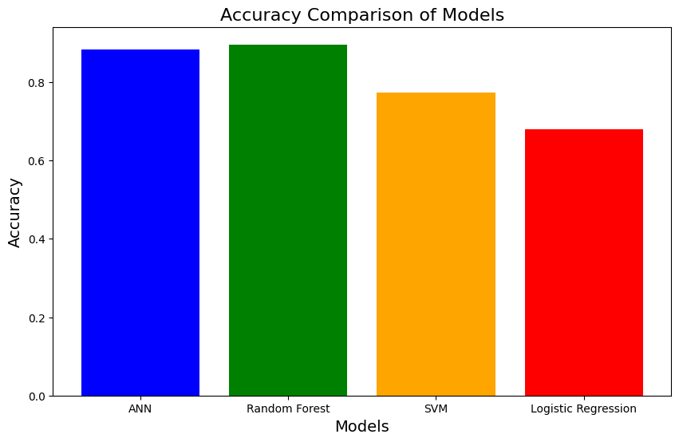
Model Comparison
The Random Forest Model outperform other models, so Random Forest model is selected as best model and deployed as pickle file for web application.
Models | Accuracy
ANN | 88.22%
Random Forest | 89.59%
SVM | 77.23%
Logistic Regression | 67.99%

Slide 28
Web application functionalities
Home, About Us, and Contact Us Pages: The platform features informational pages to introduce the website and provide contact details.
Community and Admin Pages: The system includes a Community Page for users to interact and an Admin Page for monitoring and management.
Community Page Login and Signup Options:
Login Button: Users enter their email, password, and employee ID to log in.
Forgot Password Option: Sends an OTP to the registered email, allowing users to reset their password.
Signup Process: Users fill in details like username, email, mobile number, password, confirm password, age, and gender. Upon successful signup, the system generates and displays an Employee ID for reference.
Duplicate Validation During Signup: The system checks if the username, email, or mobile number are already registered. If they are, it displays a message prompting the user to try different credentials.

Slide 29
Web application functionalities
Community Forum Access: After logging in, users can post messages and view others' messages on the Community Forum.
Threat Detection in Posts: The system analyzes user posts for potential threats:
Non-Threatening Messages: Displayed on the forum for all users.
Threatening Messages: Blocked from posting, reported to the admin, and not visible to users.
Admin Login: Admins can log in to the Admin Page to manage and review detected threats.
Threat Monitoring Dashboard: Admins have access to a dashboard displaying threats in table and chart formats for comprehensive monitoring.
Threat Details in Table Format: The table lists username, message, and threat description, providing clear insights into flagged activities.

Slide 30
Web application functionalities
Permanent User Blocking: Admins can permanently block users from accessing the platform if their behavior violates the terms.
Blocked User Login Restriction: If a blocked user attempts to log in, the system displays a message stating, "You are blocked."
User-Friendly Password Reset: The Forgot Password functionality ensures a secure and seamless password recovery process through OTP verification.
Employee ID Management: The system automatically generates unique Employee IDs for users during signup, ensuring user identification and reference.
Enhanced Security: The platform emphasizes security by detecting malicious content, preventing threats from spreading, and giving admins control over user activities.

Slide 31
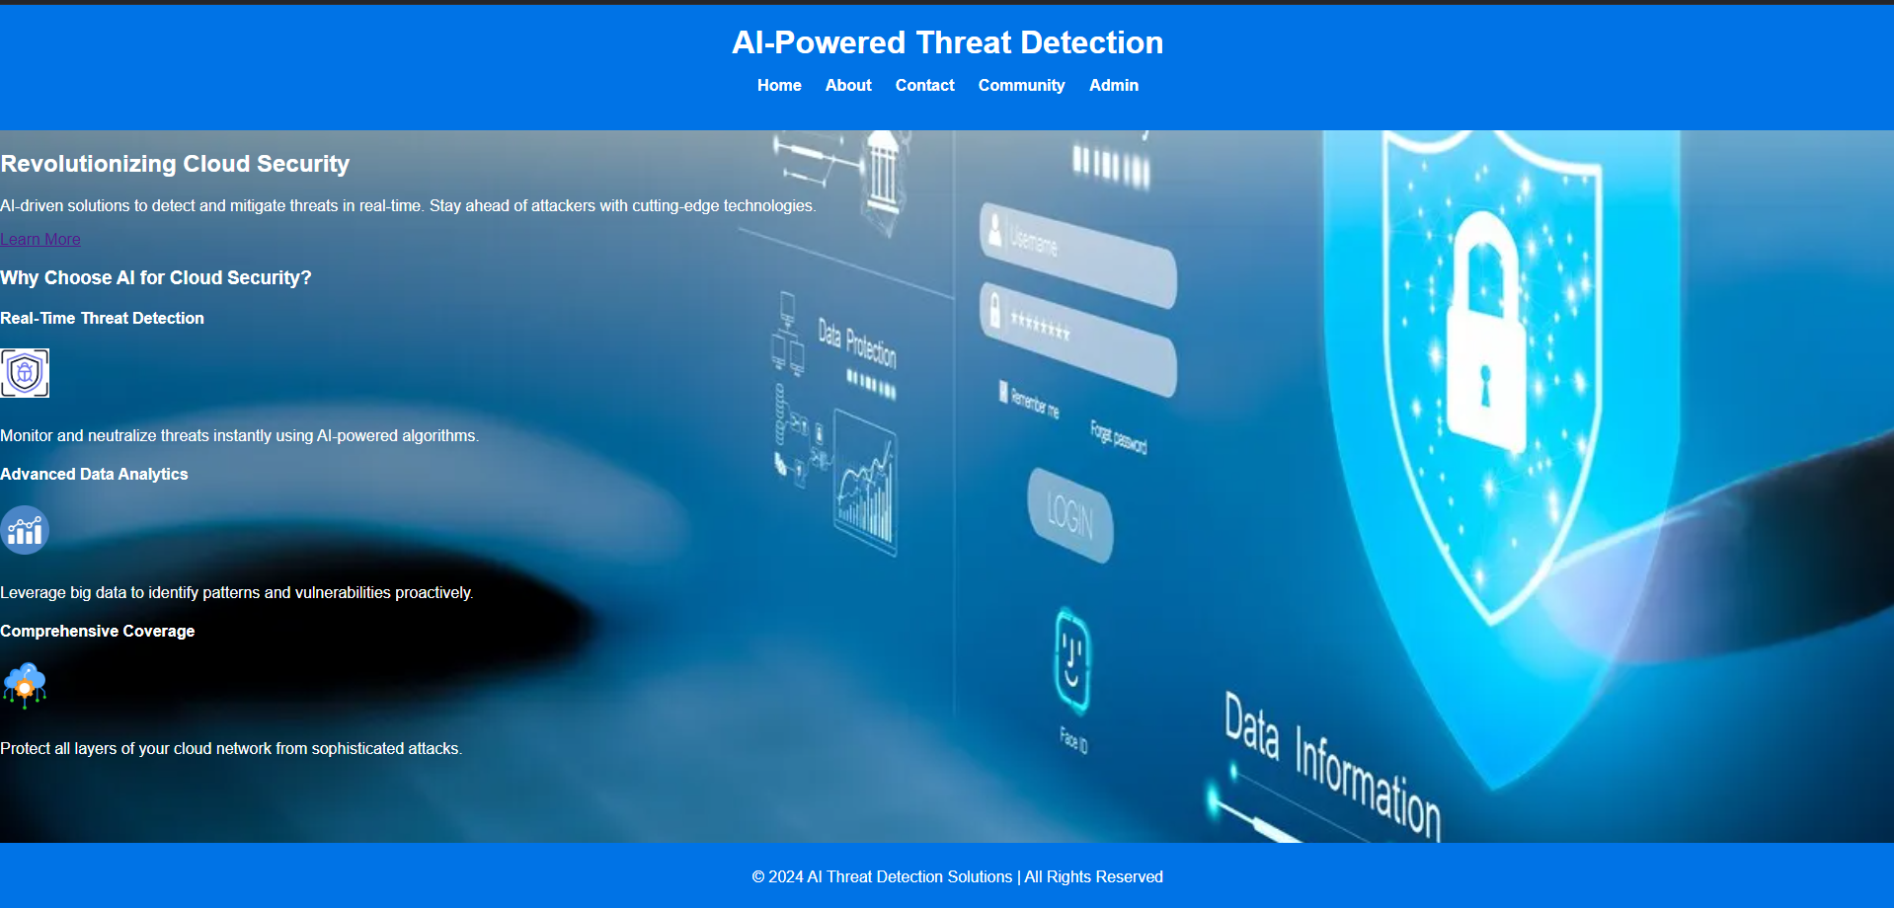
Home Page
This home page consist of basic information about website and its usage.

Slide 32
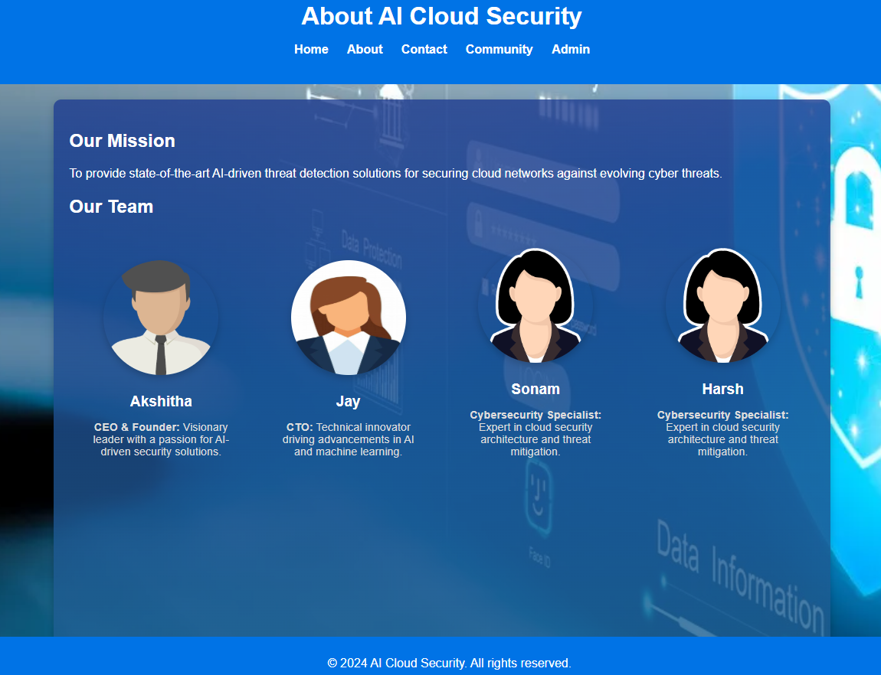
About Us - Page
About team and the mission of the organization is mentioned is the about us page.

Slide 33
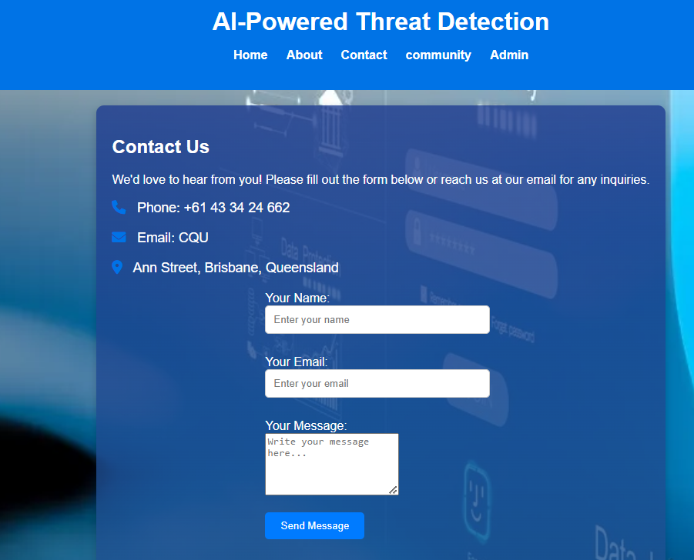
Contact us page
Contact information, such as phone number, address and email-id are mentioned in the contact us page.

Slide 34
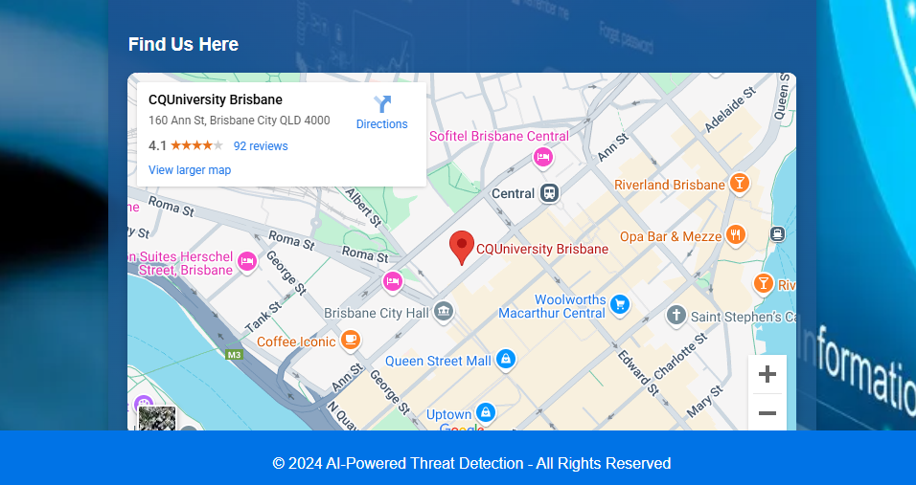
Find Us – Location page
The location of the organization is given in the form of google map, which is added as advanced feature in the contact us page.

Slide 35
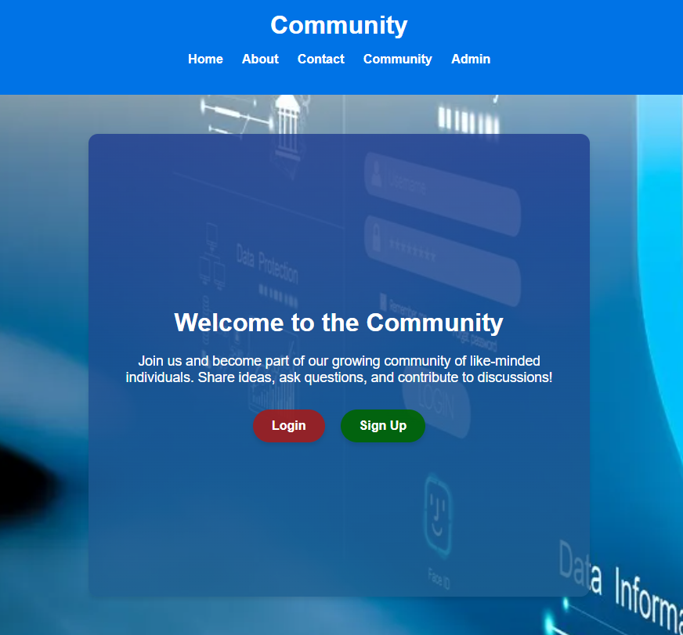
Community Login/Signup Page
If the user clicks community Nav bar, then it will re directs to the community page, which has both login and signup buttons for the user(Employees).

Slide 36
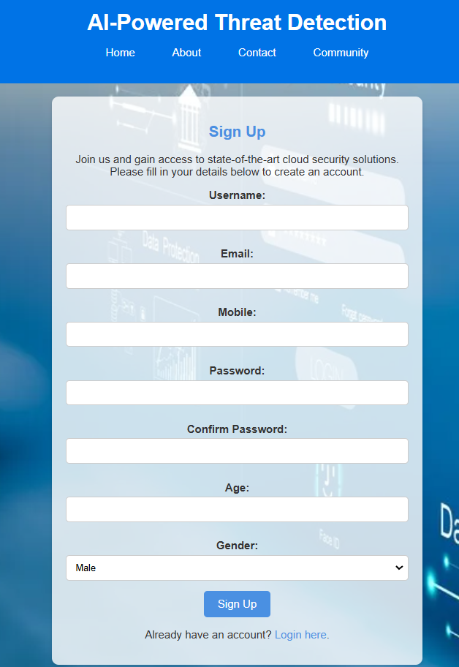
Signup Page
If user clicks signup, it will redirect to the signup form, which has username, E-mail, Mobile number, password, confirm password, age and gender.
These fields includes the email validation and strong password validation.

Slide 37
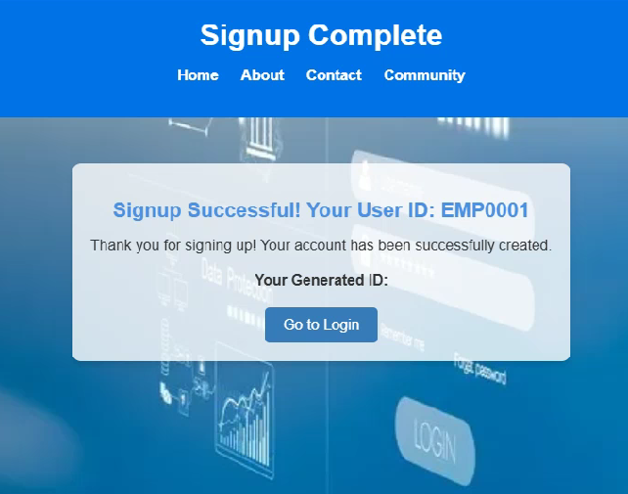
Employee ID Auto Generation
After successful signup with the input fields, the system will generate employee id and notify the user to use while login into the account.

Slide 38
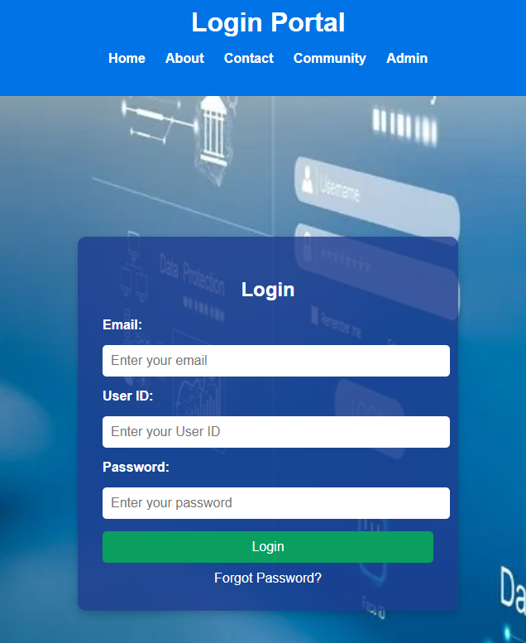
Login Page
After signing up, the user can login from the signup page also user can go to community nav bar and click login button.
The user must type their registered e-mail id, and employee id and then password.
This page has forgot functionality and also if the user forgot the password the they will get OTP to the registered mail id to reset the password.

Slide 39
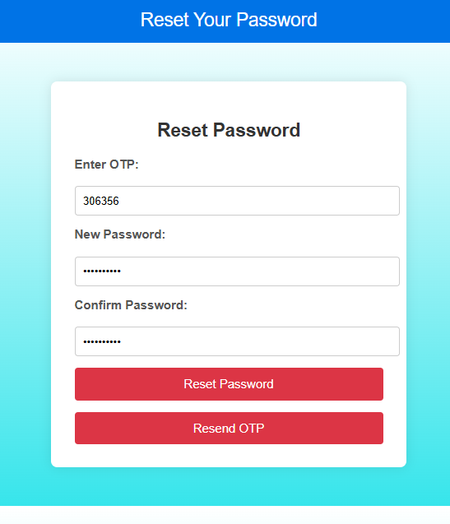
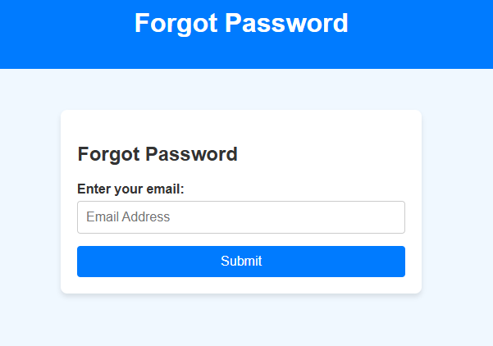
Forgot Password Page
If the user, clicks forgot password then user needs to enter their registered mail-id and need to enter OTP.
Then should enter the new password and confirm the password again.

Slide 40
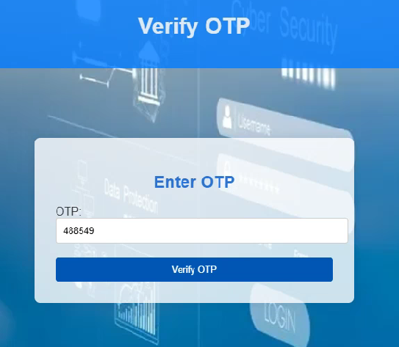
OTP Page (2-step verification)
After resetting the password or else, login with correct credential will redirect OTP page and then the system will send OTP from admin mail to the user’s registered mail id. After successful verification, it will redirect to the user account.
It will resent the OTP, if OTP is mismatch.

Slide 41
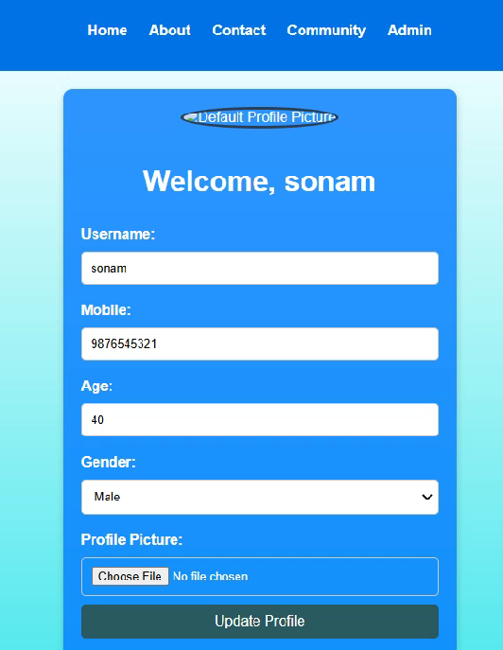
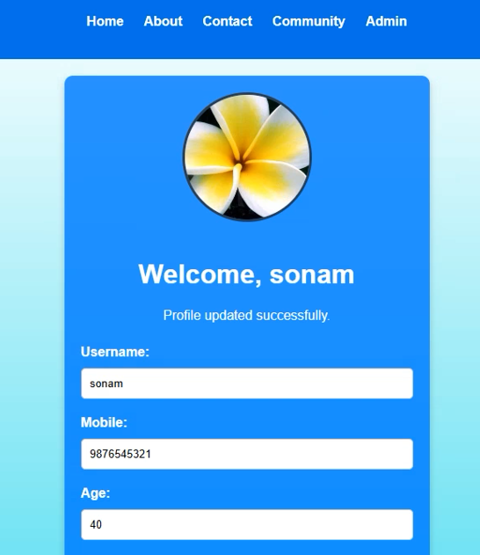
User Profile
Once the user is logged in after successful OTP verification, then user will redirect to the community account page, and it shows the profile page of the user and displays the welcome message.
User can edit update their profile also can be able to upload profile photo.

Slide 42
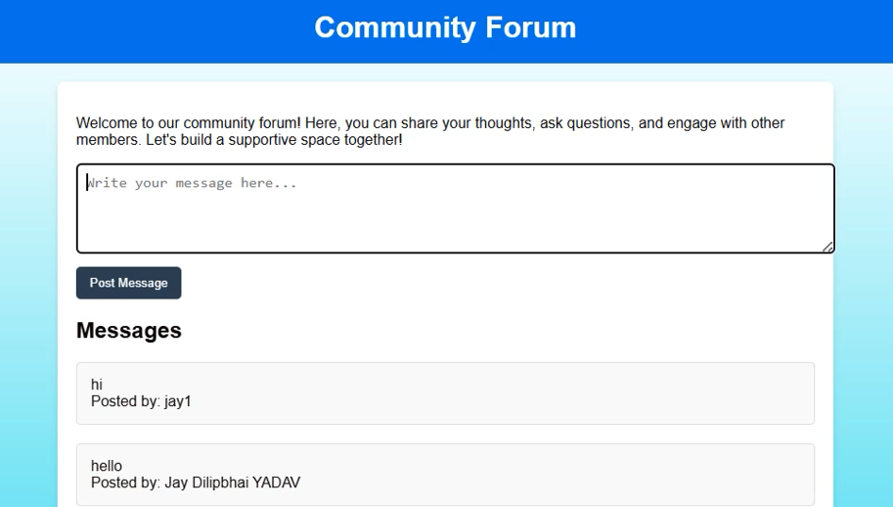
Community Forum
In this page the user can, post their message, thoughts etc.
Also, the user can see their post and posts done by the other users.

Slide 43
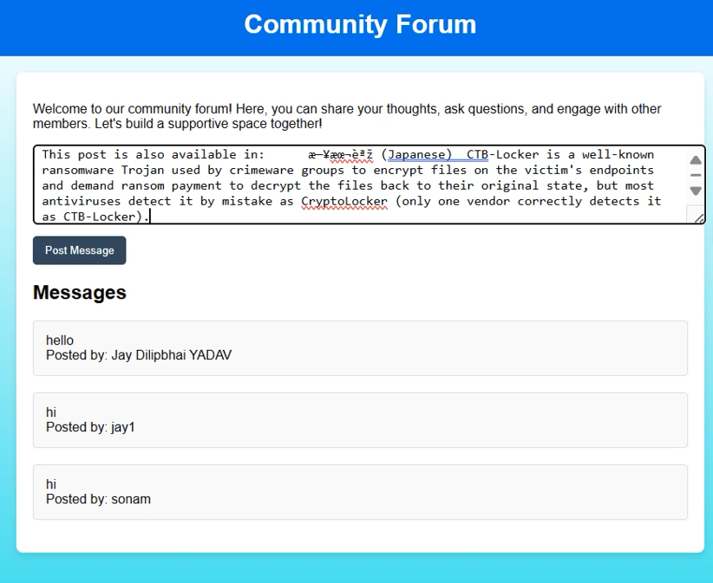
Posting Message
This screenshot shows that, text typed by the user. If user clicks post message, then, then typed text will be cleaned, pre-processed, vectorized and then it will be predicted using Random Forest trained model.
If the text is detected as threat, then the message will not be posted in the community forum and then the system will directly report to the admin.

Slide 44
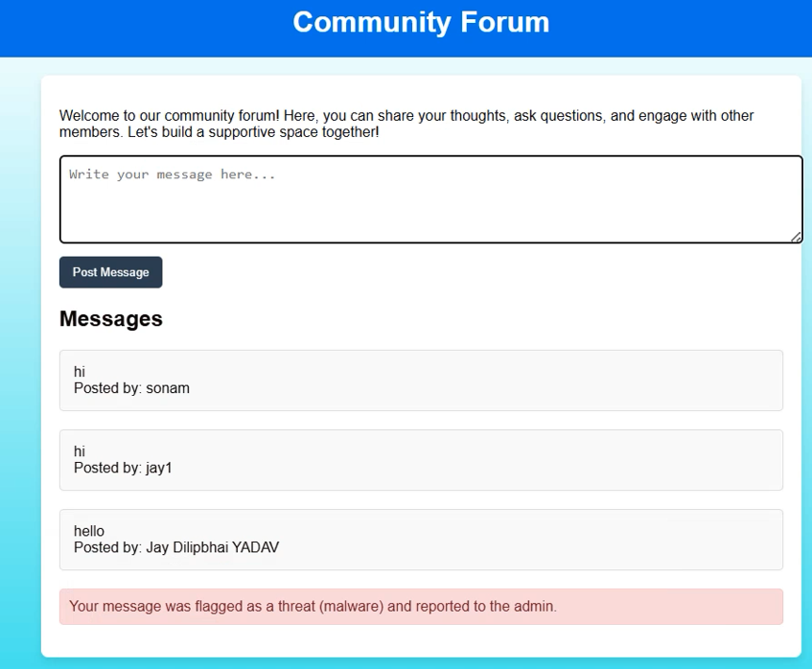
Updated Community Forum
The system notifies the user as the posted message was predicted as threat and it was flagged and reported to the admin.

Slide 45
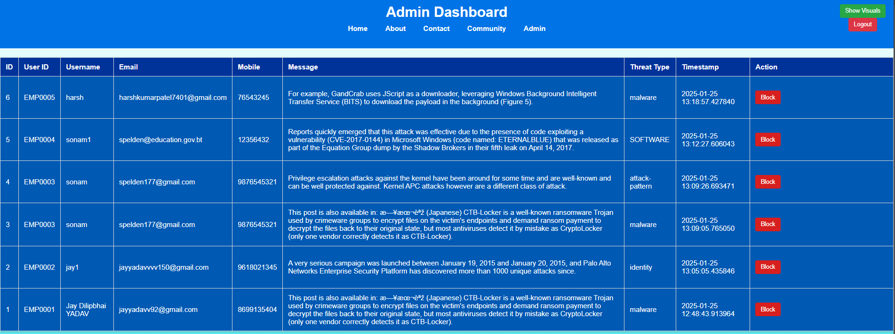
Admin Dashboard
Admin dashboard list the number of records that are detected as threats with their ids and details. If admin clicks block button in the row, then the respective user will be blocked permanently and they unable to login.

Slide 46
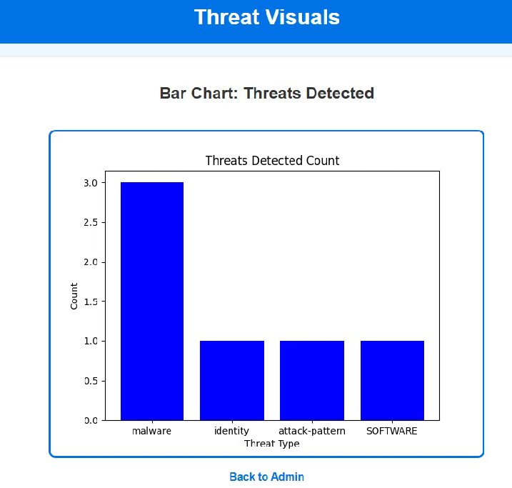
Admin (Statistics – Bar Chart)
If the admin clicks show visuals button, then admin can see graphical representation for distribution of detected threats with its categories.

Slide 47
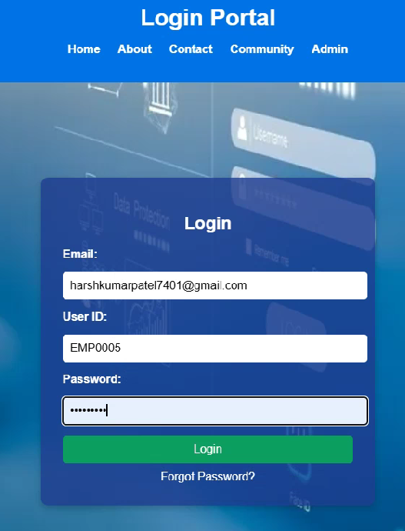
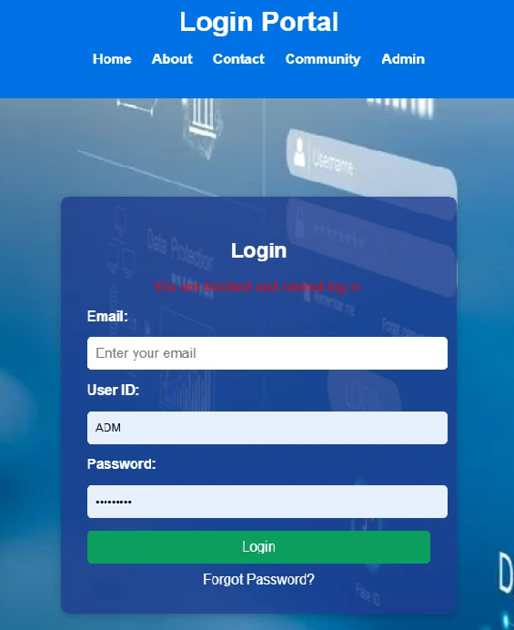
Notification of Blocked User
If blocked user wants to login into the community, then it will notify that, “your account was blocked!”.

Slide 48
References
Bhardwaj, A.K., Dutta, P.K. and Chintale, P. (2024) 'AI-Powered Anomaly Detection for Kubernetes Security: A Systematic Approach to Identifying Threats,' Deleted Journal, 2024, pp. 142–148. https://doi.org/10.58496/bjml/2024/014.
Bibi, I., Akhunzada, A. and Kumar, N. (2022) 'Deep AI-Powered cyber threat analysis in IIoT,' IEEE Internet of Things Journal, 10(9), pp. 7749–7760. https://doi.org/10.1109/jiot.2022.3229722.
Mallikarjunaradhya, V., Pothukuchi, A.S. and Kota, L.V. (2023) 'Overview of the strategic advantages of AI-Powered Threat intelligence in the cloud,' Journal of Science & Technology, 4(4), pp. 1–12. https://doi.org/10.55662/jst.2023.4401.
Nacheva, R. and Azeroual, O. (2024) 'Security of AI-Powered Systems: threat intelligence on the edge,' 2020 4th International Symposium on Multidisciplinary Studies and Innovative Technologies (ISMSIT), pp. 1–6. https://doi.org/10.1109/ismsit63511.2024.10757185.
Unlu, O. (2025) 'Top cloud security Statistics in 2024,' Edge Delta, 17 January. https://edgedelta.com/company/blog/cloud-security-statistics#:~:text=See%20Edge%20Delta%20in%20Action&text=However%2C%20the%20cloud%20is%20not,users'%20statistics%2C%20and%20more.&text=The%20cloud%20security%20market%20was%20valued%20at%20$20.54%20billion%20worldwide%20in%202022.&text=Data%20breaches%20exposed%20more%20than,the%20fourth%20quarter%20of%202023.&text=Large%20enterprises%20hold%20the%20most%20significant%20cloud%20security%20market%20with%2079%25.
Wang, B.-X., Chen, J.-L. and Yu, C.-L. (2022) 'An AI-Powered Network Threat Detection System,' IEEE Access, 10, pp. 54029–54037. https://doi.org/10.1109/access.2022.3175886.

